Slide 1
S&P 500 Pair Trading with OPTICS and LSTM
Joyce Bi Yixin Wu Charlie Hou

Slide 2

This Presentation is only for tutorial not for real investment

Slide 3
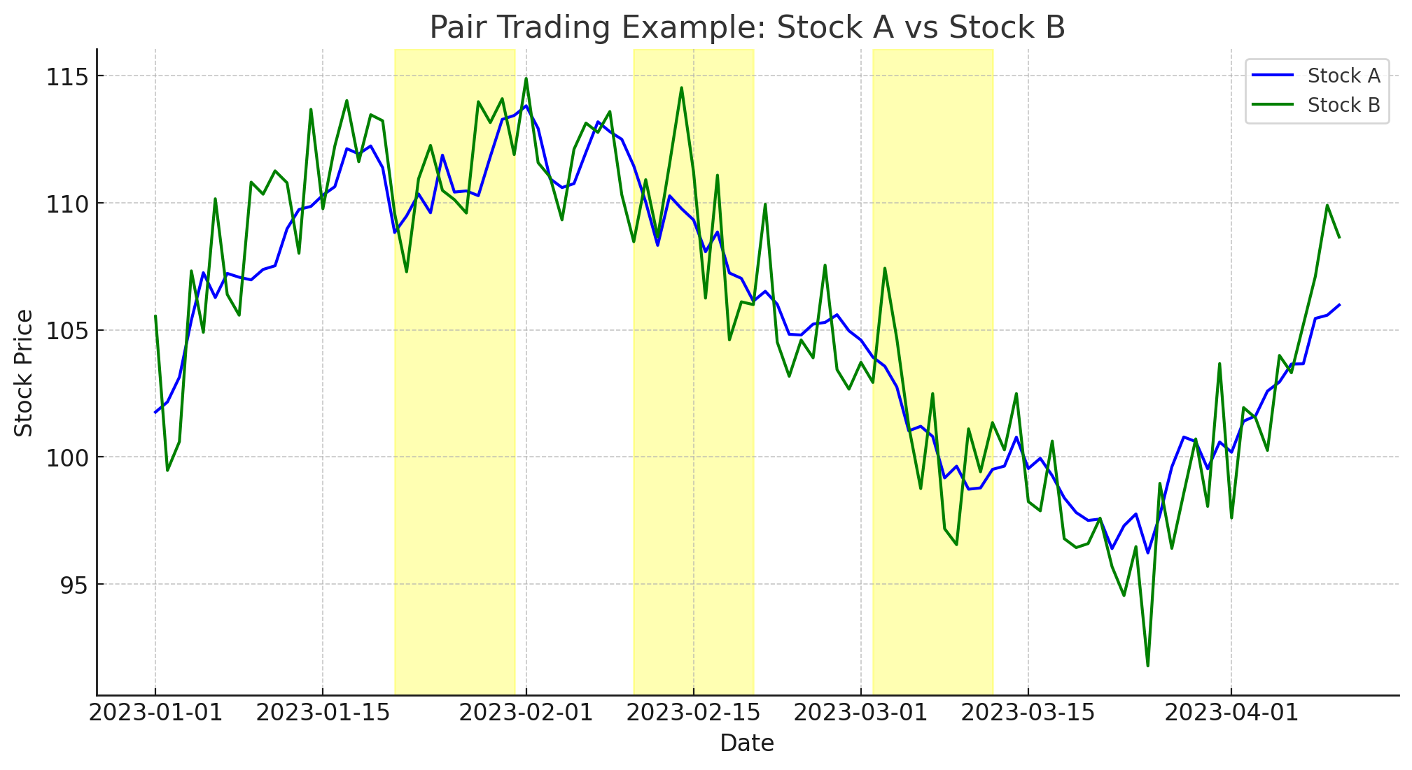
What is Pair Trading
Pair trading is a market-neutral trading strategy that involves matching a long position with a short position in two stocks with a high correlation. The core idea is to capitalize on the divergence in price movements between the two stocks, which are expected to move together based on historical patterns or fundamental similarities.
Notes:
So what is pair trading? Assume we have a correlated pair of stocks, we calculate the spread between these two stocks. If the spread becomes larger than the average, we short the overperforming stock and buy the underperforming stock. When the spread goes back to average, we stop trading and make profits.

Slide 4

Question
How to find the correlated stocks?
How to trade?
Notes:
In general, we have two core questions for pair trading — how to find the correlated stocks and how do we trade them?

Slide 5

Answer!!!
Use OPTICS Clustering Algorithm for Stock Pairing
Use LSTM to generate Buy/Sell Signals
Notes:
In this project, we apply Machine Learning algorithms on pair trading. We use OPTICS Clustering to find the correlated pairs of stocks and LSTM to generate Buy and Sell signals.

Slide 6
EDA
Retrieve the ticker symbols and respective sectors of companies listed in the S&P 500 from the Wikipedia page
Get everyday “Close Price” of each stock from Yahoo Finance API from 2010/01/01 to 2023/12/13
Calculate the “Daily Return” from “Close Price” for each stock
Retrieve all of the data frames of stock which sector is “Information Technology”
Standardize the “Daily Return” with StandardScaler in Sklearn
Drop the null values in each dataframe
Notes:
Let’s start with the EDA. Our first step is to retrieve the tickers of SP500 stocks from Wikipedia. And then, we get everyday “Close Price” of each stock from 2010/01/01 to today. Then, we calculate daily returns from the close price for each stock. We clean the data, drop the null values and standardize the “Day Return” with Standard Scaler in Sklearn. We retrieve all of stocks which sector is “Technology Information”. Finally we got 64 IT stocks from SP500.

Slide 7
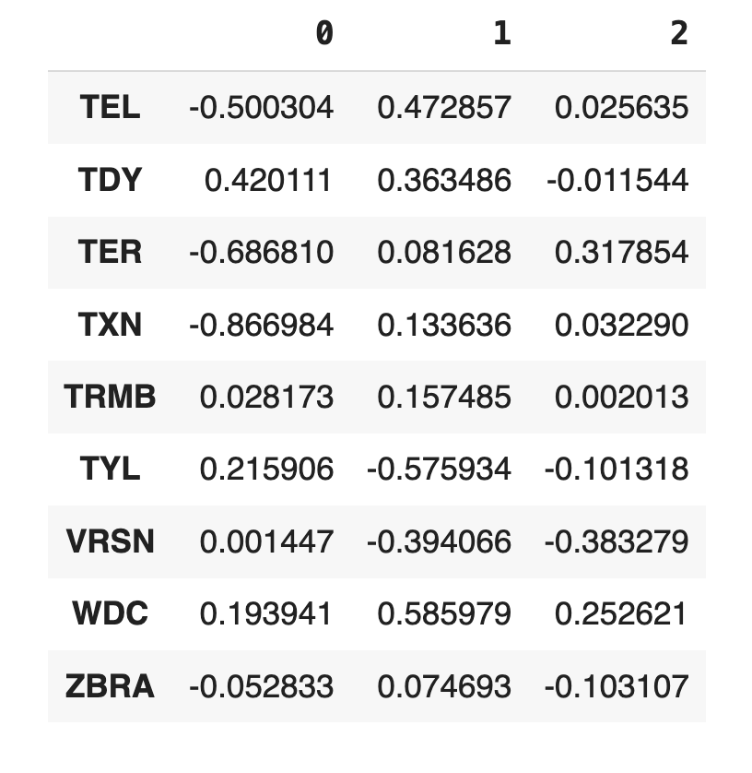
PART ONE
64 IT Stocks from S&P 500
Step One
PCA
n_components = 3
PCA
Principal Component Analysis (PCA) is a statistical technique used for dimensionality reduction in data analysis and machine learning. It involves transforming high-dimensional data into fewer dimensions (principal components) while retaining most of the variation in the data. This is achieved through standardizing the data, computing the covariance matrix, and then performing eigenvalue decomposition to determine the principal components.
CLUSTER
&
Pairing
Notes:
Now, let’s get into the Part One: finding the correlated pairs of stocks. Our first step is to use PCA to reduce the dimensions of stock features. In this case, we set the n_components to 3 which means we will retrieve the top 3 important features from our stock. Here is a part of our results.

Slide 8
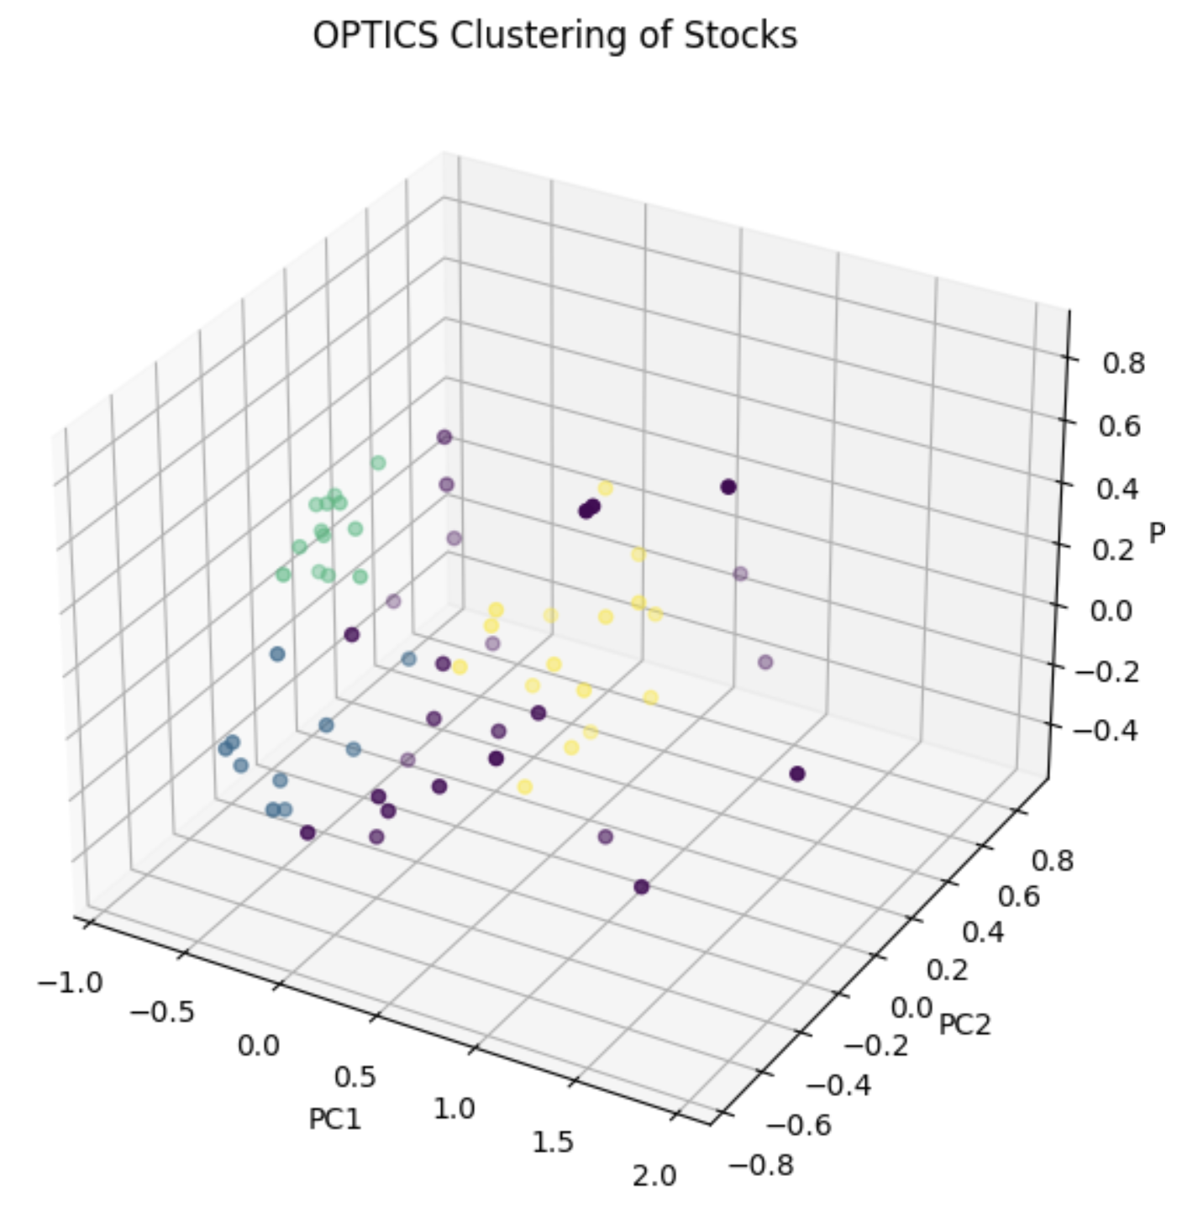
Step Two
OPTICS Clustering
PART ONE
OPTICS (Ordering Points To Identify the Clustering Structure) is an algorithm used for clustering data. It's similar to DBSCAN (Density-Based Spatial Clustering of Applications with Noise), but with key improvements that allow it to identify clusters of varying densities.
min_samples = 5
CLUSTER
&
Pairing
Notes:
After we implement the PCA, we use OPTICS algorithm to cluster our IT stocks. OPTICS algorithm clusters the data based on the overall density. Here is the plot of our results, you can see the different clusters are in different colors.

Slide 9
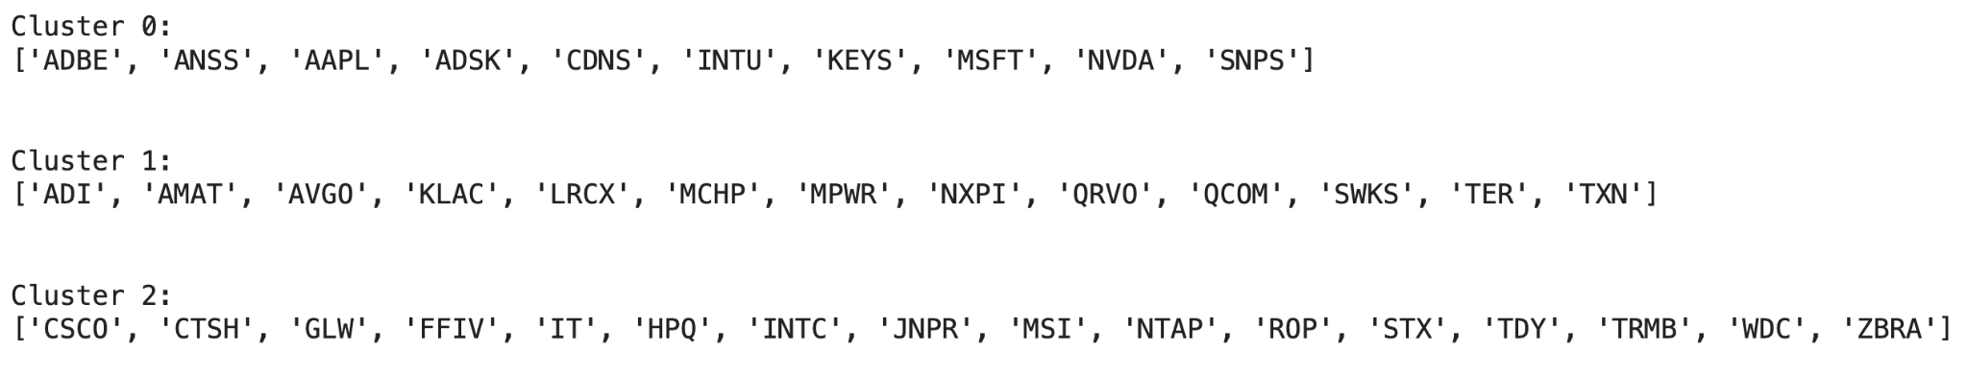
Step Three
Pairing
PART ONE
CLUSTER
&
Pairing
Price Spread Stationary?
Hurst Exponent < 0.5
Stock A and B Cointegrated?
Engle-Granger test:
P_value < 0.05
Notes:
After we classify the stocks into different clusters, we can finally do the pairing. You can see that there are three qualified clusters of stocks. In each cluster, we are going to pass each pair of stocks into 2 steps. The first step is to check whether the two stocks are cointegrated? If they are, we move on to the second step that is to check whether the price spread between them are stationary. If the price spread of the two stocks is also stationary, we get a pair of correlated stocks.

Slide 10
PART ONE
CLUSTER & Pairing
Result
Cluster 0 Pairs of stocks that are cointegrated and whose price differences exhibit mean-reverting behavior: [('CDNS', 'SNPS')]
Cluster 1 Pairs of stocks that are cointegrated and whose price differences exhibit mean-reverting behavior: [('ADI', 'MCHP'), ('ADI', 'MPWR'), ('AMAT', 'NXPI'), ('LRCX', 'NXPI'), ('QRVO', 'SWKS')]
Cluster 2 Pairs of stocks that are cointegrated and whose price differences exhibit mean-reverting behavior: [('CSCO', 'TDY'), ('NTAP', 'TDY'), ('WDC', 'ZBRA')]
Notes:
Boom! Check it out! This is our result.

Slide 11
Step One
Data Preparation
PART
TWO
70%
10%
20%
2010/01/01 ~ 2023/12/05
Training
Validation
Test
Trading with LSTM
Window Size for LSTM: 60 days
Preprocess Data: use a window of the last 60 days to predict the 61st day
look_back = 60
price_difference_normalized = (price_difference - np.mean(price_difference)) / np.std(price_difference)
X, y = preprocess_data(price_difference_normalized, look_back)
Notes:
After we get the correlated pairs of stock, we can get into the Part Two - Trading! In this part, we set up a LSTM model to generate buy and sell signals. The data we pass into the LSTM is the price spread between a pair of stocks. The first step, of course, is the train-test split. We set up 70% of our data to training set, 10% for validation set and 20% for test set. And then, we set up the window size of LSTM to 60 days, which means we use the data in the past 60 days to predict today’s data.

Slide 12
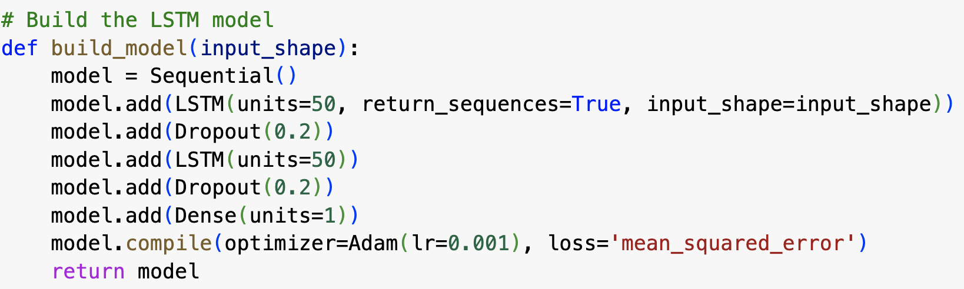
Step Two
PART
TWO
Training and Optimization
Build the Model
Trading with LSTM
Adam Optimizer/ 0.001 Learning Rate/ Mean Squared Error
Train the Model
epochs = 100 / batch size = 32
Notes:
In the next step, we build, optimize and train our model. You can find that we use Adam Optimizer, set learning rate to 0.01, use MSE as our loss function. For the training part we set the epochs to 100 and batch size to 32.

Slide 13
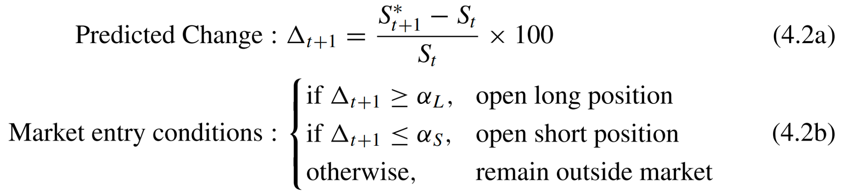
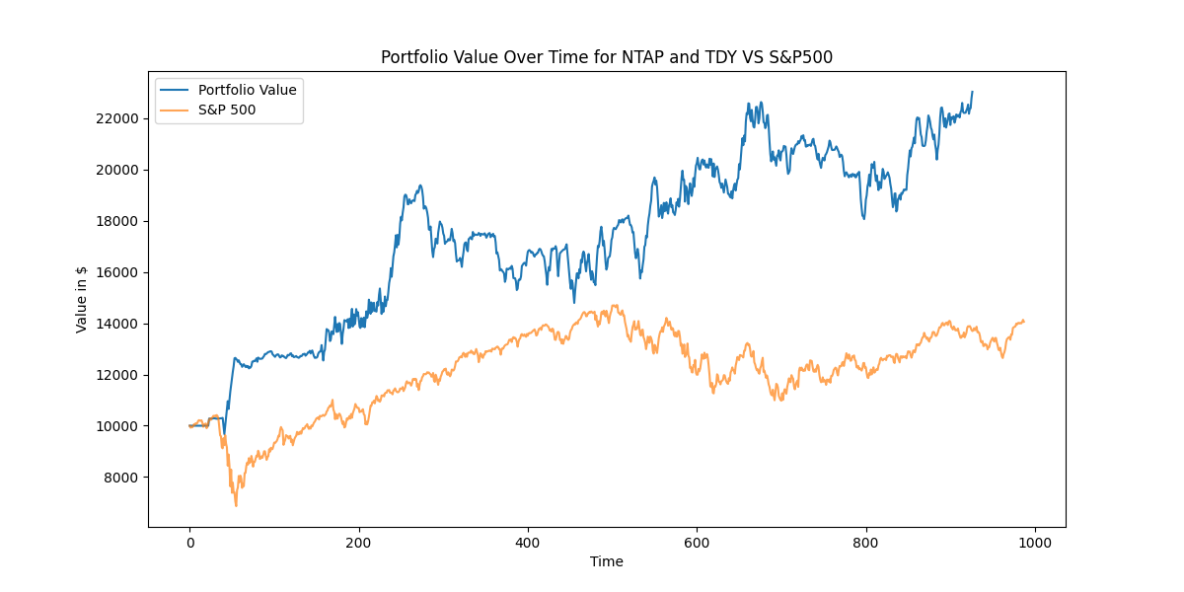
Step Three
Backtest & Evaluation
PART
TWO
Trading Logic - Buy Threshold: 0.3 / Sell Threshold: -0.3
Evaluation
Trading with LSTM
Final Return
Metric for the model: Test MSE
Metrics for the project:
Sharpe Ratio
Max Drawdown
Notes:
Finally, here is the last step for our trading part: backtest and evaluation. After we get the predicted price spread, we calculate the percentage change between predict value and real value. If the percentage change is larger than buy threshold which is 0.3 in our case we open the long position. If the percentage change is smaller than sell threshold which is -0.3 in our case we open the short position. The metric we use to evaluate the model is MSE. The metric we use to evaluate our final backtest results are final return, shape ratio, and max drawdown. Here is a plot showing our strategy results VS sp500 index. We did pretty well.

Slide 14




Code Structure
ML Pipelining
Debugging
App development
Fine Tuning
Selecting Models
Research Branch
Develop Branch
+
+

Slide 15
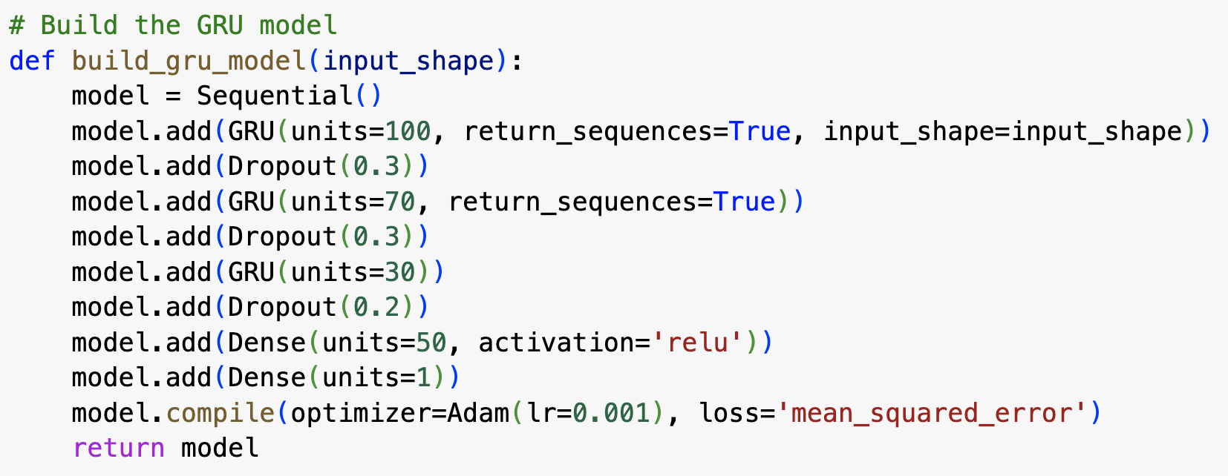
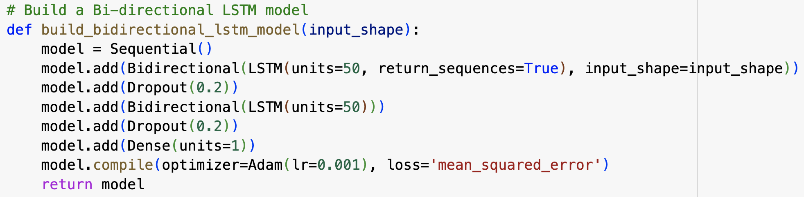
Code
Structure
Select the best Model
Research
Branch
Fine Tune Hyper Parameters
n_components in PCA | min_sample in OPTICS
Optimizer / Learning Rate | Buy/Sell Threshold

Slide 16
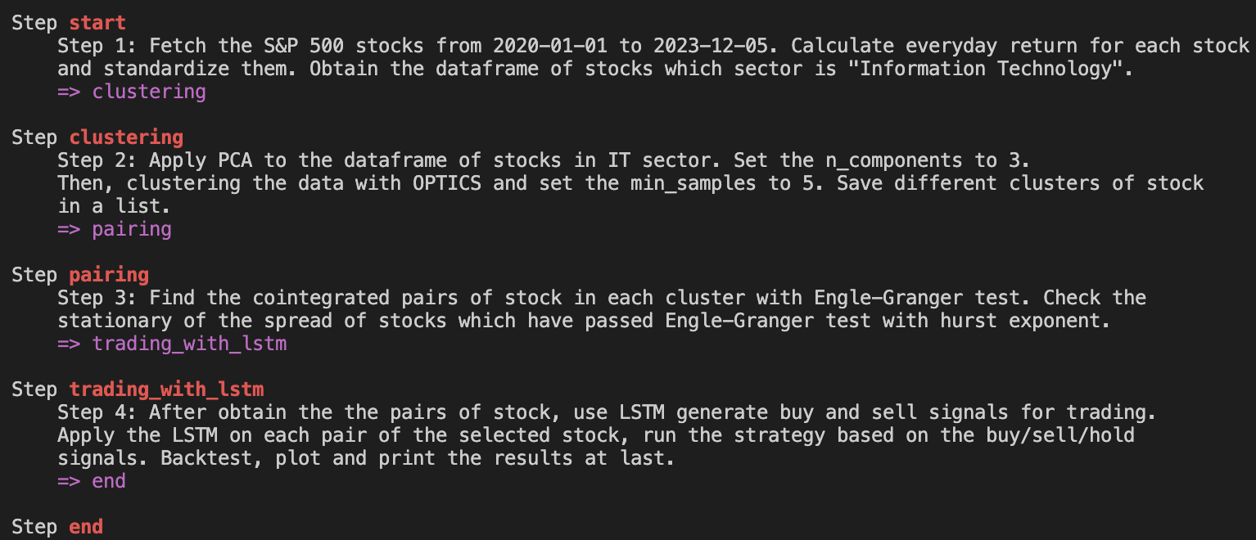
ML Pipelining with Metaflow
Code
Structure
Dev
Branch
Pass the parameters from Metaflow to Streamlit and generate an end to end interactive web page

Slide 17
Let’s check the results
Experiments on Comet:
https://www.comet.com/charlie-hou/pair-trading/view/new/panels
Our App is deployed on our local host

Slide 18

THANK
YOU
References
Pairs Trading via Unsupervised Learning
https://papers.ssrn.com/sol3/papers.cfm?abstract_id=3835692
A Machine Learning based Pairs Trading Investment Strategy
https://link.springer.com/book/10.1007/978-3-030-47251-1

